Slide 1

Tutorial T3 Derek Tan, Andre Oliver Jessica Ying, Lily Zhang

Slide 2
Scope
Design the micro-scale, mobile and automatically rendering plant
Use CAD software to draw the overall design
Simulate working process to validate the design
Conduct economic analysis

Slide 3
Actions taken regards to Audit 1 feedback
Project output
Completed requirement analysis, TPM and function analysis
Completed first version of design
Communication
Recorded communication with client
Teamwork
Created work log for each member
Created task tracking file
Decision making
Updated decision log
Others
Created file dictionary
Scheduling the visit to a commercial rendering plant
Communicating with ANU PhD’s and industry experts

Slide 4
Requirement analysis
Pairwise analysis
 | Cost | No. of containers | Safety | Stability during transportation | Assemblability | Energy consumption | Extraction efficiency of oil | Extraction efficiency of protein | Throughput | Meal grain size | Waste management | Sum | Rank
Cost |  | 0 | 0 | 0 | 1 | 1 | 1 | 0 | 0 | 1 | 1 | 5 | 6
No. of containers | 1 |  | 0 | 0 | 1 | 1 | 1 | 0 | 1 | 1 | 1 | 7 | 4
Safety | 1 | 1 |  | 1 | 1 | 1 | 1 | 1 | 1 | 1 | 1 | 10 | 1
Stability during transportation | 1 | 1 | 0 |  | 1 | 1 | 1 | 0 | 1 | 1 | 1 | 8 | 3
Assemblability | 0 | 0 | 0 | 0 |  | 0 | 1 | 0 | 0 | 0 | 0 | 1 | 10
Energy consumption | 0 | 0 | 0 | 0 | 1 |  | 0 | 0 | 0 | 0 | 0 | 1 | 10
Extraction efficiency of oil | 0 | 0 | 0 | 0 | 0 | 1 |  | 0 | 0 | 1 | 1 | 3 | 7
Extraction efficiency of protein | 1 | 1 | 0 | 1 | 1 | 1 | 1 |  | 1 | 1 | 1 | 9 | 2
Throughput | 1 | 0 | 0 | 0 | 1 | 1 | 1 | 0 |  | 1 | 1 | 6 | 5
Meal grain size | 0 | 0 | 0 | 0 | 1 | 1 | 0 | 0 | 0 |  | 1 | 3 | 7
Waste management | 0 | 0 | 0 | 0 | 1 | 1 | 0 | 0 | 0 | 0 |  | 2 | 9

Slide 5
Requirement analysis
Safety
Extraction efficiency of protein
Stability during transportation
No. of containers
Throughput
Construction Cost
Extraction efficiency of oil
Meal grain size
Waste management
Assemblability
Energy consumption

Slide 6
Key Functions
Receive and deliver
Receive and deliver energy
Receive
Receive a start signal and provide a ready signal
Process
Process insects into meals and oils
Collect
Collect the final products
Control
Control the system automatically

Slide 7
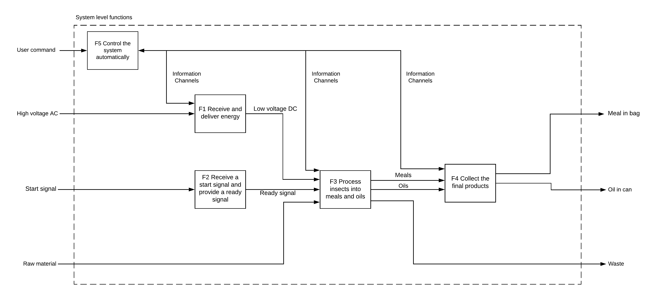
Functional analysis

Slide 8
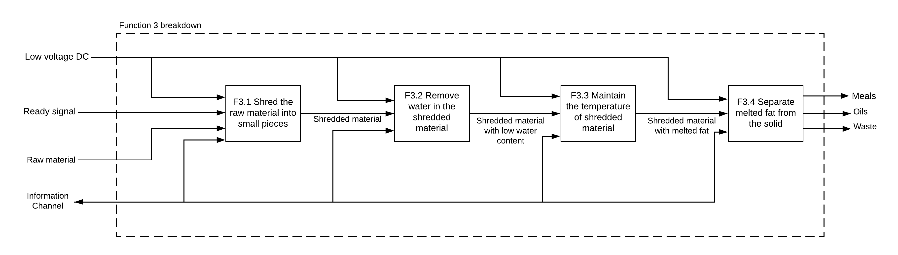
Subfunctions
Shred the material
Remove water
Maintain temperature
Separate fat

Slide 9
TPM
 | Technical Performance Measure
Int No. | Interest Area | SI Unit | Target Value | Description
1 | Input Material | kg | ~1176 | The material set by the client that the unit should be able to process (assuming) per day
2 | Throughput | kg/s | … | The amount of material that will be able to be fed into the system per second
3 | Breaker Output | ~mm^3 | 20-25mm | Reccomended by render tech to be around the units as described, this is the material that will now undergo processing
4 | Pre-Cooker Temperature | C | 90-100 | Standard industrial temerpature at which material is heated to partially evaporate the material
5 | Pre-Cooker Pressure | Psi | 10-15 Psi (1) | Standard industrial pressure at which pre-cookers operate
6 | Evaporator Plant Temperature | C | >100
7 | Conveyer Throughput (pre-cooked material) | kg/s |  | Conveys the material from the Precooking Module to the Continuous cooking module
A | Ventillation Pre-Cooking/CC Phase | m^3/min | ~9-15 (3) ** | Ventillation of the system will need to be examined to be able to keep the surrounding container temperature low. 4 industrial fans should be able to achieve the ventialltion specified.
8 | Continuous Cooker (CC) Temp. | C | ~120 | A chamber that rotates through the material, heating and evaporating the remaining water in the material
9 | Continuous Cooker (CC) Press. | Psi | ~145 (2) | An industrial standard using by animal material renderers.
10 | CC Held Material | kg | …
11 | CC Throughput (cooked material) | kg/s | …
B | CC Containter Temperature | C | <<< 450 (4) ** | Set by international bodies, the temperature specified is the recognzed minimum temperature at which envirmental objects may experience combustion. This is therefore the minimum temperature goal, however taking into account the human aspect (ie how vulnerable are humans) we may set this to a lower value
12 | Percolator Temp | C | >100 | The percolator essentially cycle the material (with the water removed) and the liquid fat present, there the compnent cannot be allowed to cool otherwise the animal fats presetn will solidify.
13 | Percolator Volume | m^3 | …
14 | Percolater throughput | kg/s | …
15 | Seperation Material Temp. | C | >100
16 | Decanter Throughput | kg/s | …
17 | Seperator Throughput | kg/s | …
18 | Fat-Press Throuput | Kg/s | …
C | Seperation Chamber Temp./Press. | C/Psi | <<< 450 (4)

Slide 10
3D model for our preliminary design

Slide 11
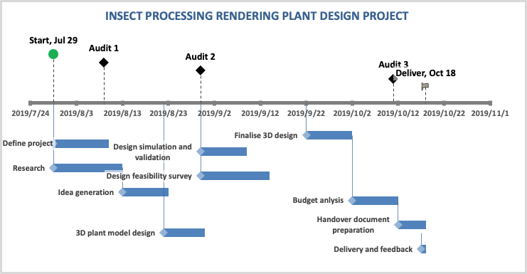

Slide 12
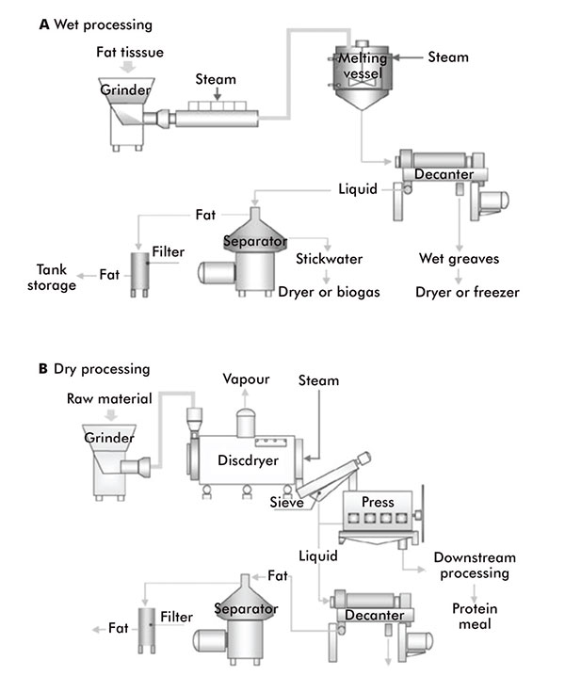
Decision Procedure
1. Internet search how they work and their cons and pros.
2. Check which process is more popular in the market on animal fat extraction processing – the manufactures and the companies who are using the plants.
3. Evaluate the processing designs by using technical importance ratings.
4. Stakeholder opinions, especially our client Goterra.
(Lipid lore: Oils, fats and waxes, 2019)

Slide 13
Experts from Specilist Fields
Alibaba – the companies who sell the similar components/products we design in our project.
RenderTech – a company who has a large amount of experience on designing rendering plant
CAD designers at Zhengjiang Univeristy– supports us on drawing details and giving feedback on the feasibility of our drawings.
Material and machincal phDs at ANU– provides us guidance on the design validation.
SouthernMeat – a company that has a running insect rendering plant.

Slide 14
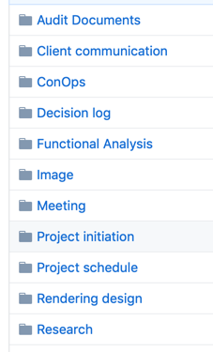

How to find our files?

Slide 15
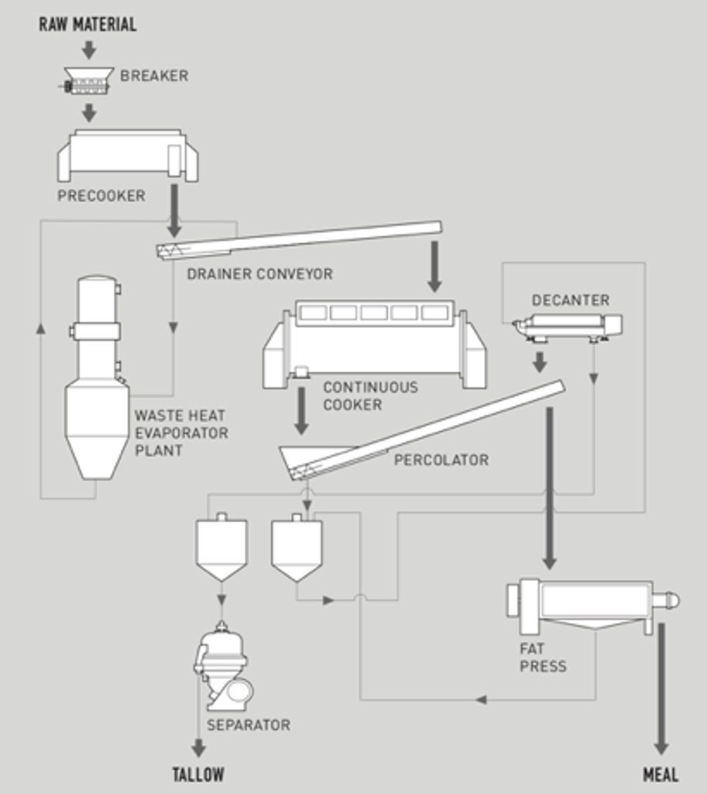
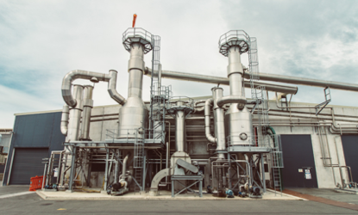
(RenderTech, 2019)

Slide 16
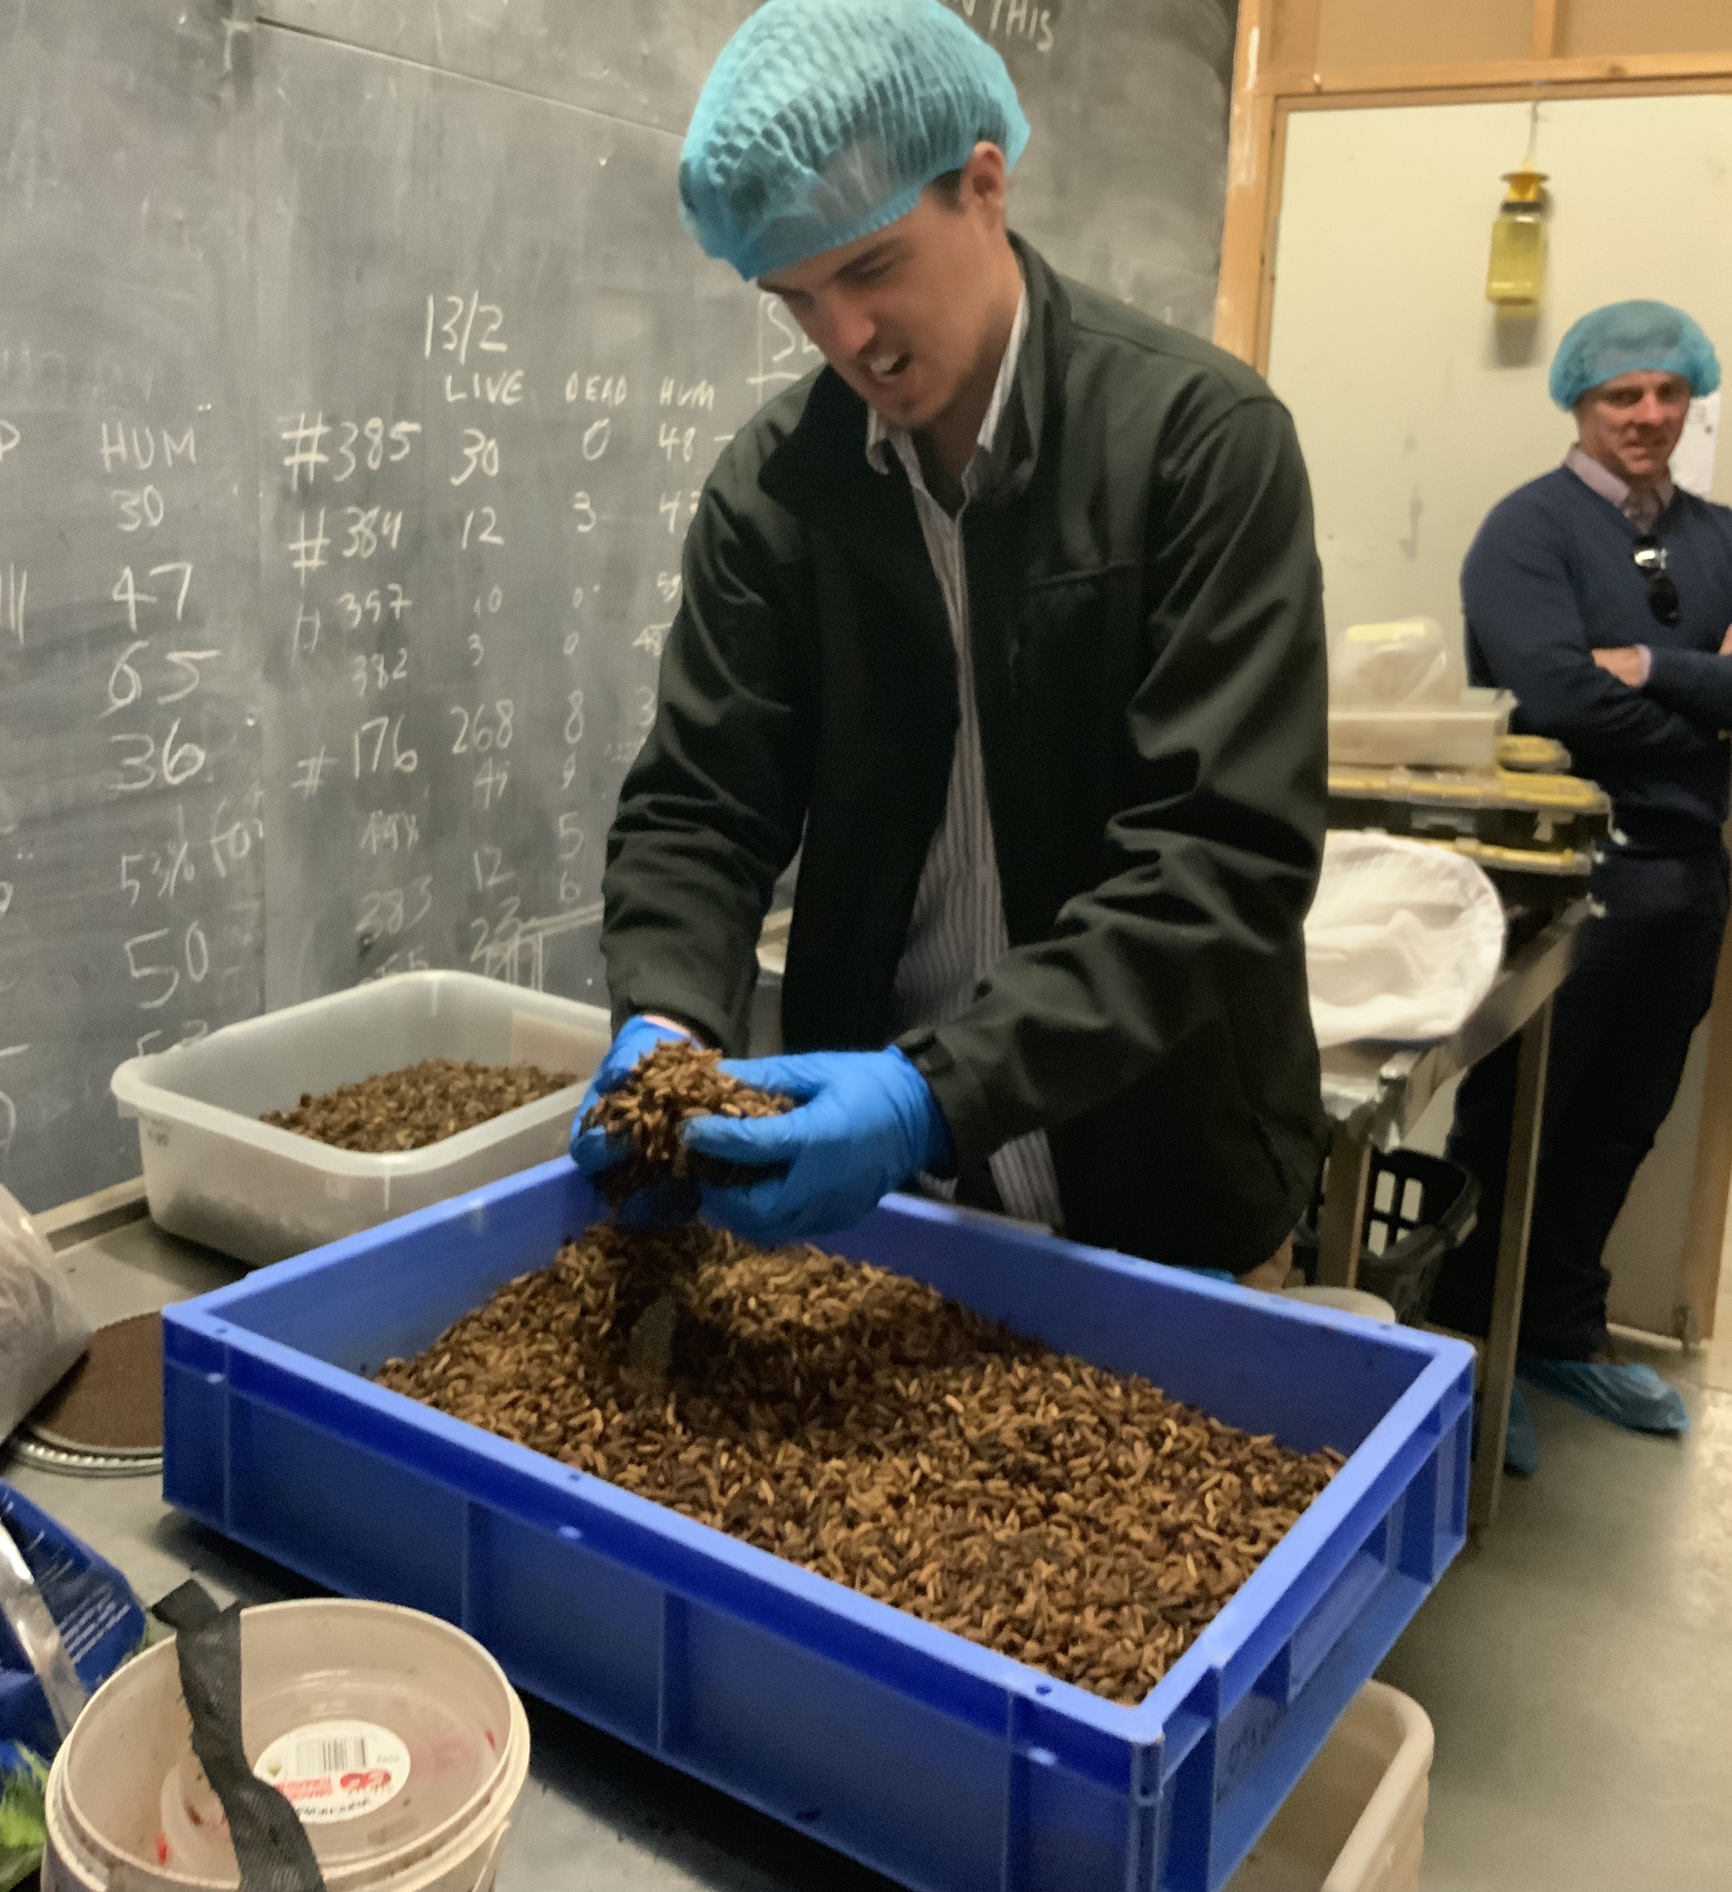
Question time

